Slide 1
Introducing more technology to the Arts
Alissa Beckett, Alex Smejkal, Levi Sutton, Hope Shackelford

Slide 2
Abstract
To create a VR video game simulating a coloring and activity book. The user interacts with a menu to navigate the game. The activities place the user in a white void and allow them to create and paint within it in order to:
Color
Connect the dots
Solve a puzzle
Two surveys were sent to sample populations representing current high school students and adults. This will be discussed in later slides.

Slide 3
Realignment
We decided half way through this project to realign our project to properly meet our goals, and instead of making a video game. We are going to use a VR game called Tilt Brush to demonstrate the positive effects VR Games could provide in a classroom setting.

Slide 4
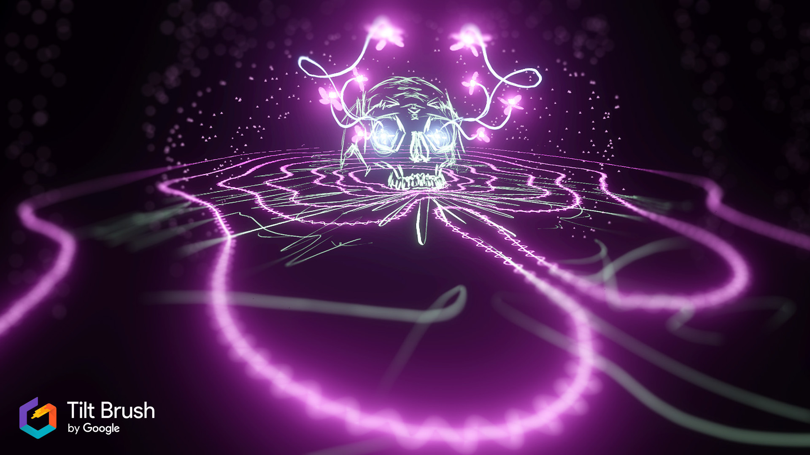
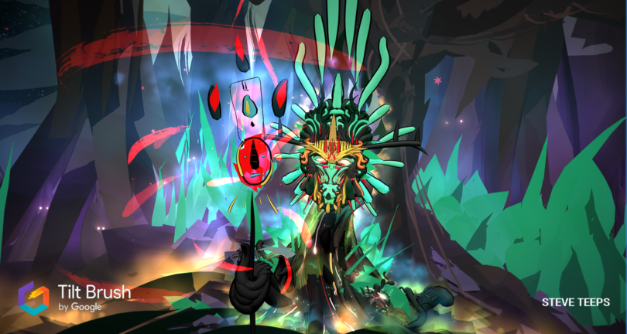
Samples from the game:

Slide 5
Background Study
Integrating the Arts with Technology: Inspiring Creativity
Discusses how art has helped many students grow and develop the important self-understanding skills that help keep them engaged
Discuss the studies that prove the strong connections between the arts and academic achievement
States how public educators are able to teach on a platform more oriented to the individual

Slide 6
Background Study
Arts Education in America: What the Declines Mean for Arts Participation
Finds that adults who have previously participated in arts education in their youth were more likely to have their future children participate in arts education as well
States that decrease in participation in the arts will equate to less funding and a continued decline in overall student participation

Slide 7
Methods of Research
We took a methodical approach to our research. We studied the following topics:
Art education in the American public school system
The benefits of art education in early childhood development
How to create a video game
How to create a VR game

Slide 8
Survey Questions
Age
How often do you draw, paint, or create two dimensional art?
What is your experience with digital art technologies(I.e. Procreate for iPad Adobe Photoshop)
What are your thoughts on digital art as a medium?
Did you participate in art classes in your teen years?
Looking back, are you satisfied with your art experiences in your teen years?
How do you feel about the current state of art programs in today’s high schools?
How do you feel about the use of technology in today’s high schools?

Slide 9
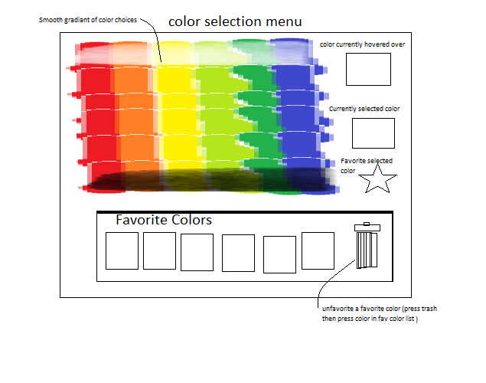
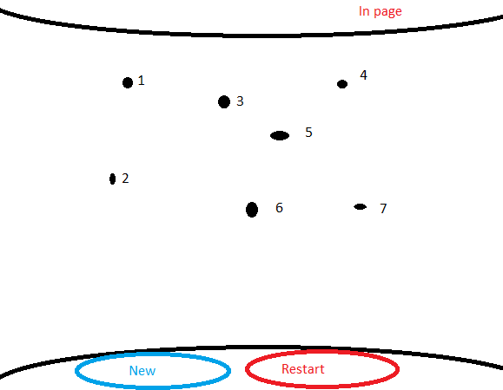
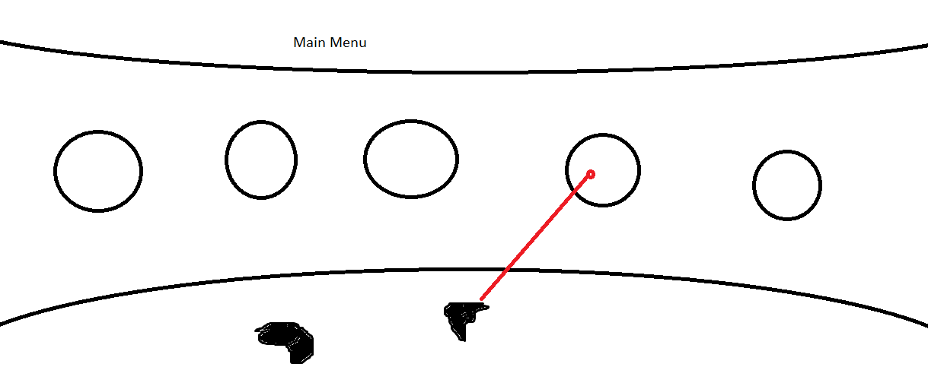
The final product goal

Slide 10
Resources used
For research:
IBA Boston
National Center for Technology Innovation and Center for Implementing Technology in Education
Rabkin, Nick, and E C Hedberg
U.S. Department of Education
For the game:
Unity software
HTC Vive Technology

